Slide 1

Library Management system
A project by:
Sohan Mitra .M (2312090)
Sateesh .M(2312008)
Department of Computer Science and Engineering
National Institute of Technology, Silchar
15th April 2025

Slide 2
PROBLEM STATEMENT
Background:
In today's education system, libraries play an important role for the students to acquire knowledge. Libraries help the students in improving their skills. We can see in some campuses the library is being handled in an offline way that is the data is handled through registers and the data about the submission is written on the book which makes the job tougher to the librarian and also to calculate the fines and also to handle the files, so we came up the management system which helps the management and the librarian to complete the work in a easy way.
Program Description:
You are tasked to design a library management system using C++ programming language. The system should provide functionalities to manage the data of books, users who are using the library separating them as different user types(students,faculty,librarian). And also manage the fine amount due to late submission, and generate the data with all the details of the books and users.

Slide 3
Features of the system
Book Management: Take cares of the data of the books available in the library in form of csv files allowing easy access.
Issuing and returning books: Allow the librarian to issue the book to the user and also accept the returned book and updating the data at each step.
Differentiating Users: Users are differentiated as students and faculty so that each have different limits of count of books they can borrow and also fines.
Displaying the details: System also display the details of account the user by asking the id which contains the data of the books borrowed, fine amount and books returned.
Calculating Fine: Allows us to calculate the fine amount based on the borrowed date and submission date and allowing them to pay the fine through the system and maintaining a csv file to follow up the transactions.

Slide 4
Important Role of OOPS
Oops plays a major role in the project the following concepts are used from oops to accomplish our project
• Classes and Objects:
The project defines various classes which have distinct entities and their own set of properties.
Objects of these classes are created and manipulated all over the program.
• Encapsulation:
Encapsulation is achieved by using access specifiers like private, protected, and public to control access to class members.
Data members of classes (Title,Author,ISBN etc…) are encapsulated within their respective classes and accessed through member functions.
• Inheritance:
The student class inherits the properties from the user class, demonstrating inheritance.
Inheritance allows student to inherit the properties (name,id,email id,phone no,) from User, promoting code reuse and maintaining a hierarchical relationship between classes.

Slide 5
• Polymorphism:
The student class inherits properties and behaviours from the User class, establishing an "is-a" relationship. This inheritance enables student objects to access and utilize the attributes and methods defined in the User class.
Method overriding, a key aspect of polymorphism, is employed in the student class to provide specific implementations of methods inherited from the superclass. For instance, the borrowBook, returnBook, getFineAmount,viewborrowBook methods are overridden in the student class . By overriding these methods, the student class provides custom functionality, distinct from that of the superclass.
• Abstraction:
Abstraction is achieved by hiding the complex implementation details of classes and exposing only relevant functionalities to the user.
Users interact with the system through high-level functions provided by the Library class, without needing to know the internal workings of the system.
• File Handling (I/O):
File handling is utilized to read and write the data from or to the external files, such as maintaining the transactions of the user(transactions.csv)
The displayBook function displays the books that are available to issue. While the addBook adds a new book to the file.

Slide 6
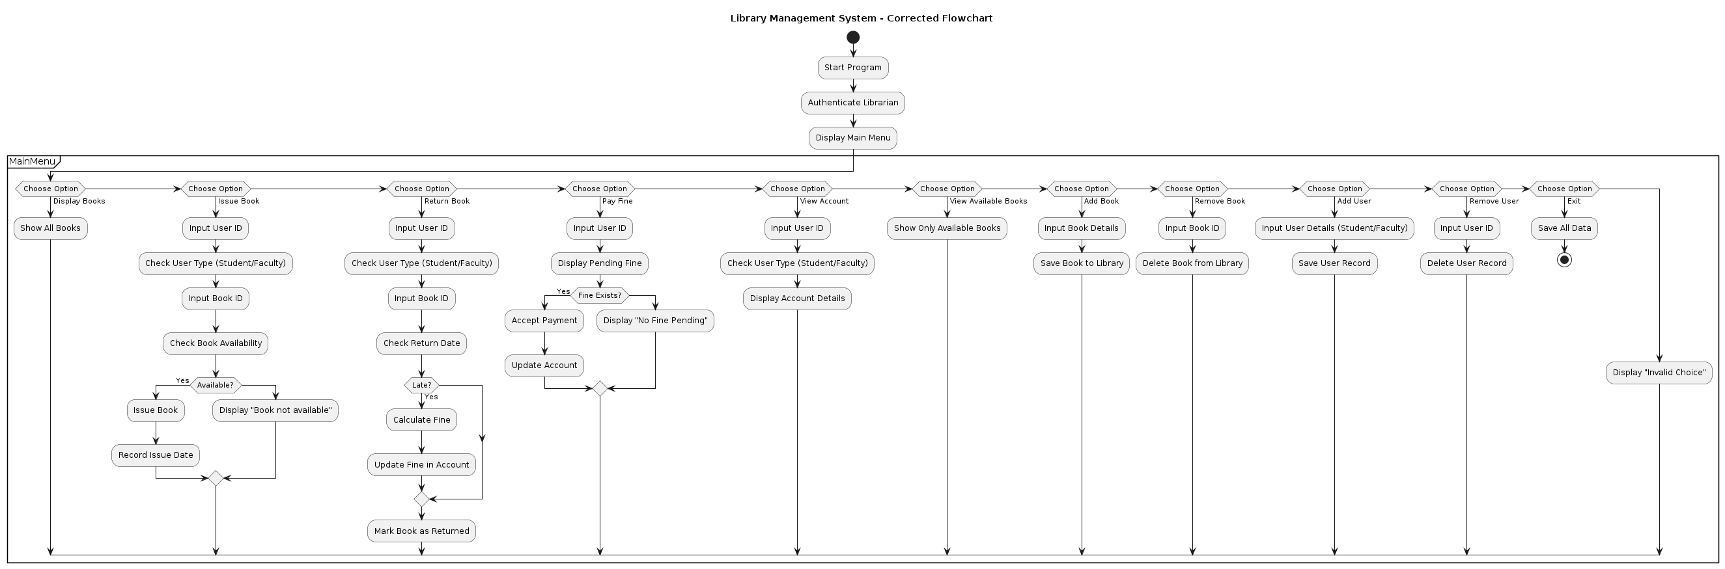
Flow chart

Slide 7
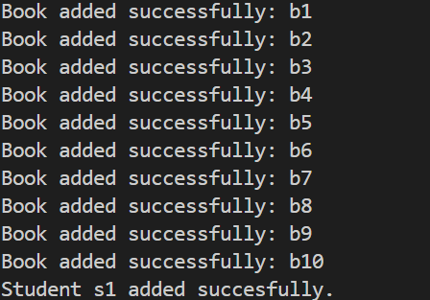
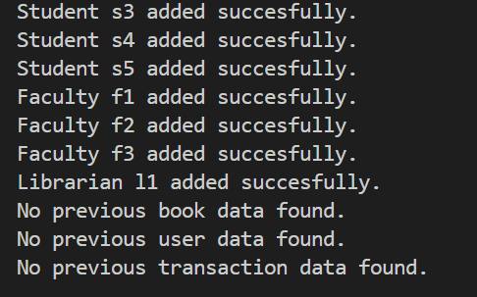
Outputs
Data already stored in the library files:

Slide 8
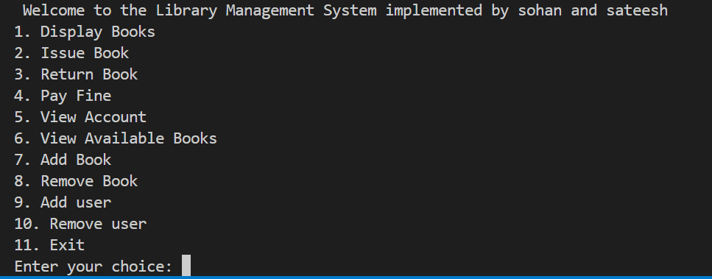
Main Menu

Slide 9
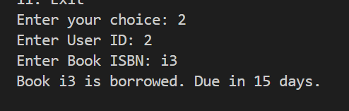
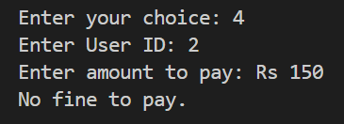
Sample outputs based on the choices:(2 and 4)

Slide 10
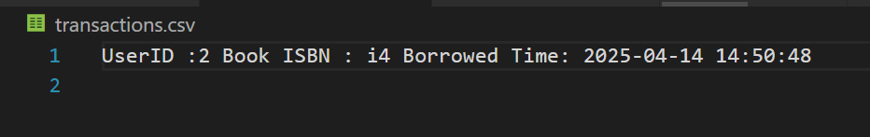
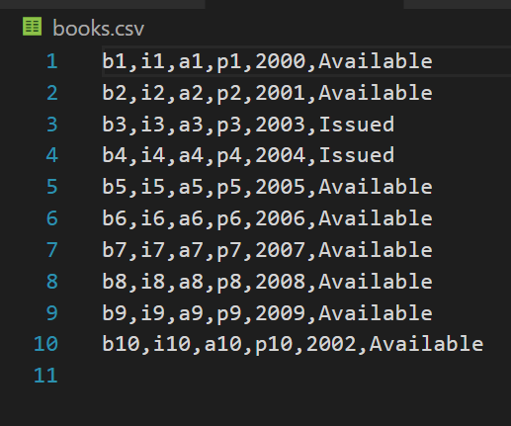
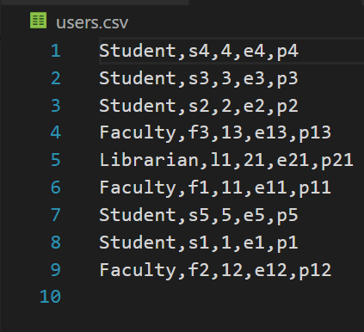
After the choices are implemented the csv files are updates as shown

Slide 11
Conclusion
In conclusion, we're grateful for the opportunity to work on our CS 212 Object-Oriented Programming project. This collaborative effort has deepened our understanding of programming principles and their real-world applications. The Library Management System we've created demonstrates our proficiency in object-oriented programming concepts.
As we wrap up this project, we're appreciative of the guidance from our instructors and support from our peers. We're excited about applying the skills learned in future projects and endeavors. This experience has been valuable in shaping our growth as programmers.
We look forward for the suggestions which we can implement in our presentation and system , also if you have any doubts we try our level best to solve them.

Slide 12
THANK YOU

